Slide 1

Impact of Aid on World-Wide Food Security
Group 5: Vlad Agache, Adrian Baniak, Kshitji Gupta, Rui Janson, Binghao Zhang

Slide 2
Outline
Introduction to the problem
Data utilised
Research questions explored using data science
Is aid effective in reducing food security issues?
Is there a type of aid that is more effective?
Do economic factors affect food security more than external aid?
Do local factors play a significant role in food security?
Does awareness of food security and aid-related issues in donor countries impact contributions?
Conclusions

Slide 3
Introduction
Food security is a basic requisite of development
Addressing world-wide food security issues is a pillar of economic development which allows developing countries to enter the global market
Aid (known as Official Developmental Assistance - ODA) is a mechanism by which developed countries contribute to addressing welfare issues in poorer countries

Slide 4
Data
Main source used was World Bank database
Aggregates data from multiple sources
Data in current $USD addresses inflation
Data available starting 1960 up to 2015
Yearly data available for 217 countries

Slide 5
Is Aid Effective in Reducing Food Security Issues?

Slide 6
Is Aid Effective in Reducing Food Security Issues?
Measures of aid:
Total Official Development Assistance (ODA) - Current USD
ODA per capita (Total ODA normalized to population) - Current USD
Measures of food security:
Food Deficit (kCal per person per day)
Undernourishment (% of population)
Notes:
Why chose 2 measures of aid: to determine if there are significant differences between the 2 indicators, since the top 10 countries receiving ODA are completely different than top 10 per capita ODA recipients
Why choose 2 measures of food security: to diversify the indicators of a complex problem, food security has many facets, and food deficit and undernourishment are 2 of those. Food deficit is the severity of undernourishment, while undernourishment is prevalence of food insecurity

Slide 7
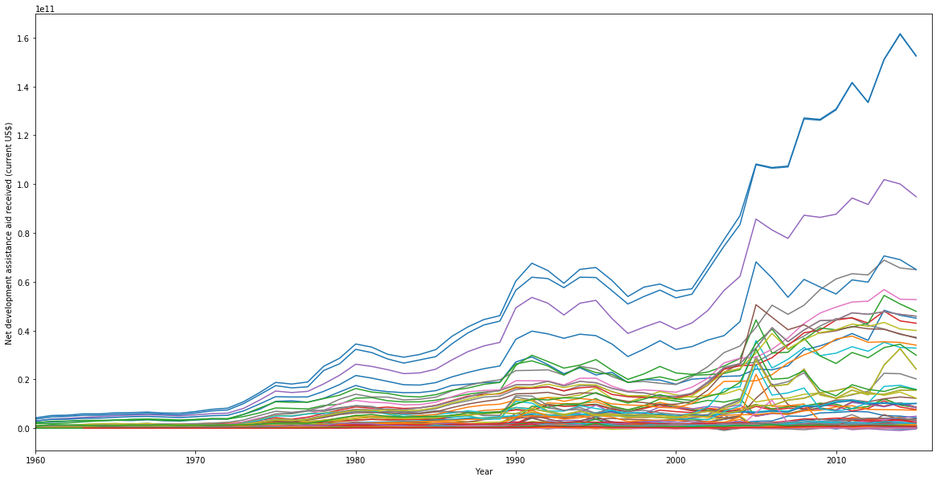
Is Aid Effective in Reducing Food Security Issues?
Total ODA received from 1960-2015
Focus analysis on data from 2000 to 2015 (last 16 years)
Notes:
Chose to focus on data from 2000 to 2015 (last 16 years), to capture recent world events (Iraq war, South Sudan, Afghanistan, Lybia, etc)

Slide 8
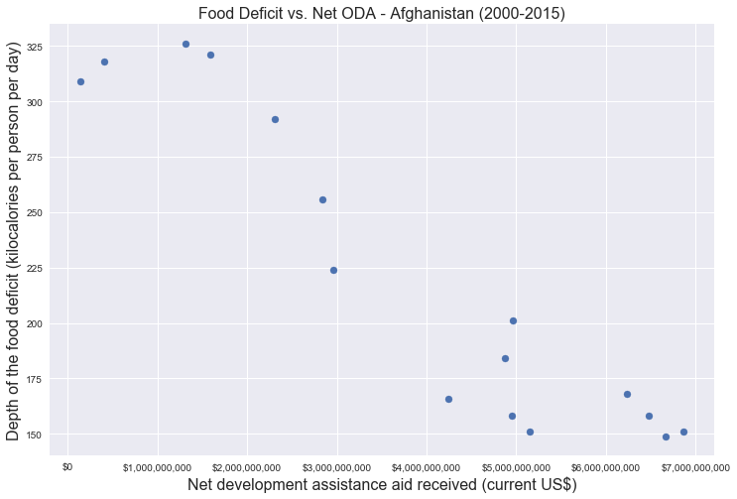
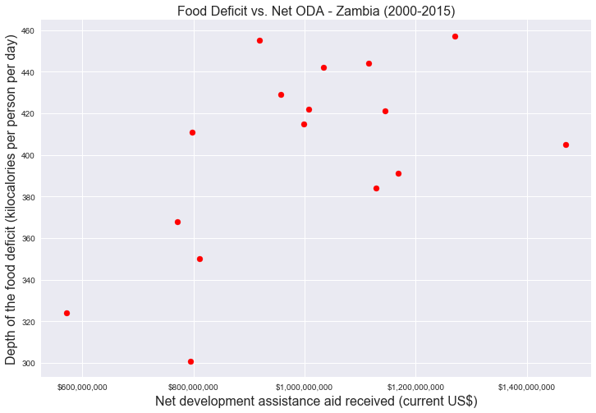
Is Aid Effective in Reducing Food Security Issues?
Relationship between aid received and food security indicators is country-specific
Relationship not necessarily linear
Notes:
Depending on country, relationship is not necessarily linear, and can have no correlation or either positive or negative correlation

Slide 9
Is Aid Effective in Reducing Food Security Issues?
Analysis Method:
Focus on recent time period of 2000-2015
Analyze each country individually
Select an appropriate score for correlation between aid and food security indicator (Spearman’s correlation coefficient)
Determine if correlations between aid and food security indicators are significant for each country
Of countries that receive aid, determine % for which there is significant correlation
Comparative analysis of results to examine patterns in results

Slide 10
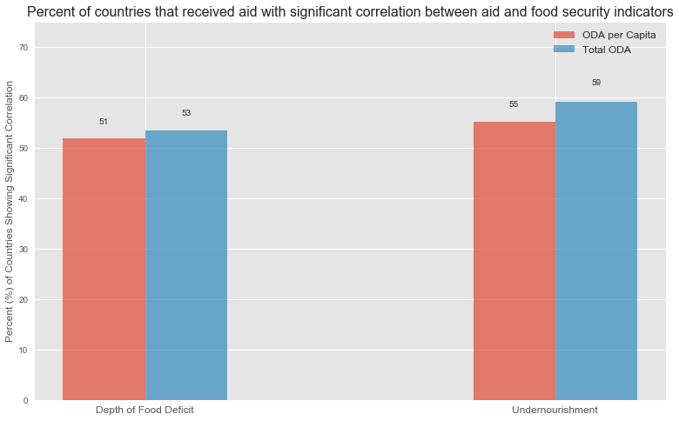
Is Aid Effective in Reducing Food Security Issues?
Summary of Results:

Slide 11
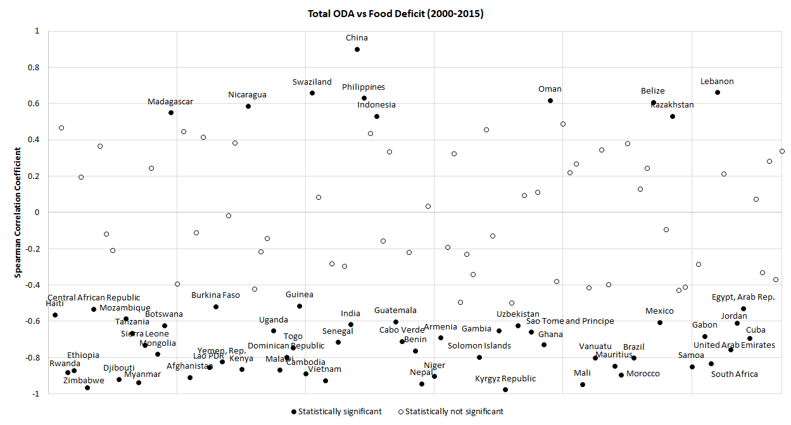
Is Aid Effective in Reducing Food Security Issues?

Slide 12
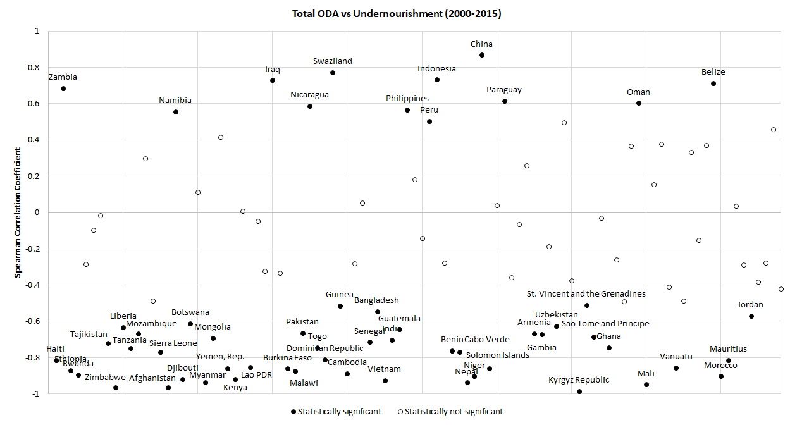
Is Aid Effective in Reducing Food Security Issues?

Slide 13
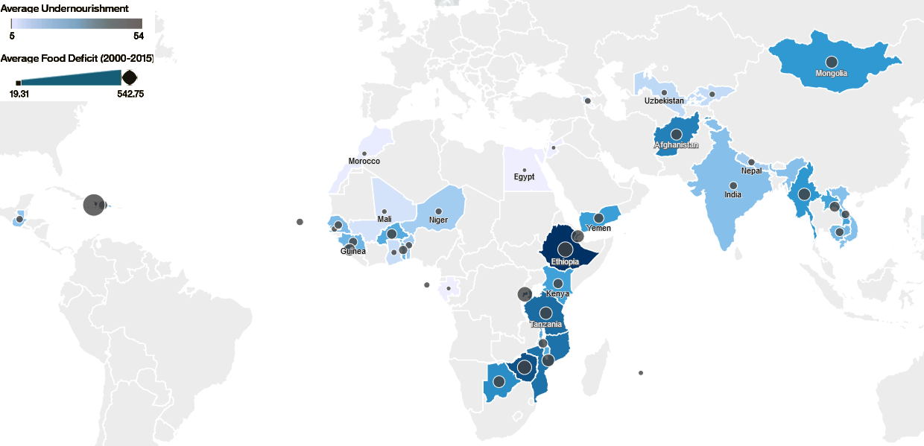
Is Aid Effective in Reducing Food Security Issues?
43 countries show significant correlation between aid received and both food deficit and undernourishment:

Slide 14
Is Aid Effective in Reducing Food Security Issues?
Observations:
Response to aid is country-specific
ODA per capita and Total ODA produce similar results
Correlation results are similar for aid vs. food deficit and aid vs. undernourishment
Positive correlations may imply increased aid due to increased food security issues
Negative correlations may imply effective reduction in food security issues with increased aid

Slide 15
What type of aid is most effective?

Slide 16
What type of aid is most effective?
Three forms of aid evaluated:
Total ODA (includes both grants and loans)
Debt forgiveness grants
General grants, excluding technical cooperation
Objective: Determine if grants have a more significant impact in addressing food security compared to total assistance (which includes loans)

Slide 17
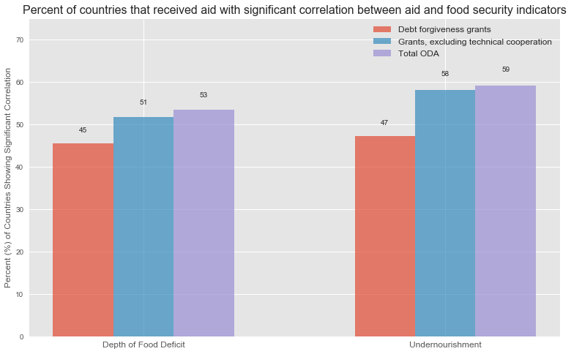
What type of aid is most effective?

Slide 18
What type of aid is most effective?
Results:
Higher number of countries were significantly impacted by Total ODA than Grants
Debt forgiveness grants are not as effective as General grants

Slide 19
Do economic factors affect food security more than external aid?

Slide 20
Do local factors play a significant role in food security?

Slide 21
Does awareness of food security and aid-related issues in donor countries impact amount contributed?

Slide 22
Conclusions and Recommendations
List of countries for which external aid helps reduce food insecurity was identified
Further funding will help reduce food security issues in identified countries

